Slide 1

Machine Learning Characteristics

Slide 2
Outline
Ill posed versus well posed problems
Inductive learning
ML algorithm versus Conventional algorithms

Slide 3
Machine Learning Definition
Definition 1 : Arthur Samuel(1959)
Field of study that gives computers the ability to learn without being explicitly programmed.
Definition 2 : Tom Mitchell (1998)
A computer program is said to learn from Experience E with respect to some Task T and some Performance measure P if performance on T, as measured by P, improves with experience E.

Slide 4
Ill posed versus Well posed Learning problems
Ill posed problems :
No clear goal/Has simultaneous goals
No clear solution paths No unique solution
“Today is Sunday. Shreyas would like to watch a movie”
Ill posed problems should be converted into a Well-Posed problem in terms of Task, Experience, and Performance
Well posed problem
Solution exists
The solution is unique
The solution depends on the data/experience
“Task : Classify whether Krish movie will be liked by Shreyas”

Slide 5
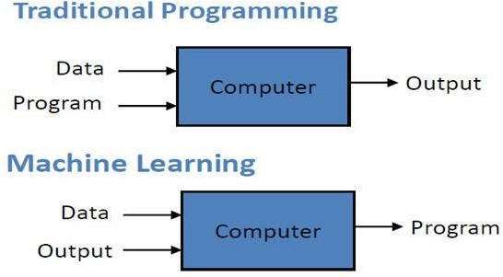
Conventional versus ML algorithms
Enable computers to learn from data without being explicitly
programmed.
2,12,3,1,14
Sorting
1,2,3,12,14
2,10,3,1,30,20
Generate Model
1,2,3,10,20,30
6,40,4,90,60,9
4,6,9,10,20,40
ai<aj; if i<j
a_{i}< a_{j} ; if i<=n/2 a_{i}=a_{(i-n/2)}*10; if i>n/2

Slide 6
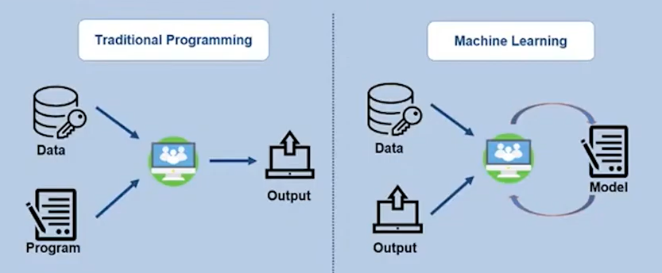

Slide 7
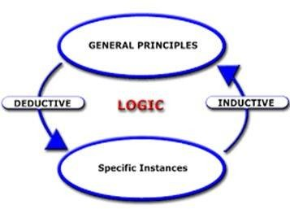
Inductive versus Deductive Learning
Force = Mass * Acceleration
t = ?
F= ?
Mass = 5 kg.
a1 | a2 | t
5 | 2 | 10
3 | 2 | 5.9
10 | 5 | 47
14 | 2 | 28
Acceleration upwards= 3.5 m/s^2

Slide 8
Machine Learning Tasks
Regression
: Generalize to predict continuous valued output
What will be share price of SBI bank after a month ?
Classification : Generalize to predict discrete valued output
Are the documents given of sports or of technology
Clustering
: Generalize to form groups
Given keywords of various documents, group the documents

Slide 9
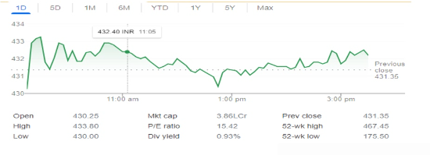
Machine Learning Tasks
Regression
: Generalize to predict continuous valued output
What will be share price of SBI bank after a month ?

Slide 10
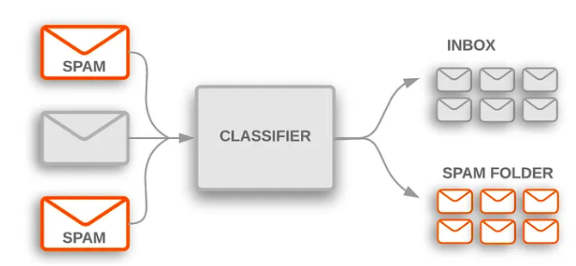
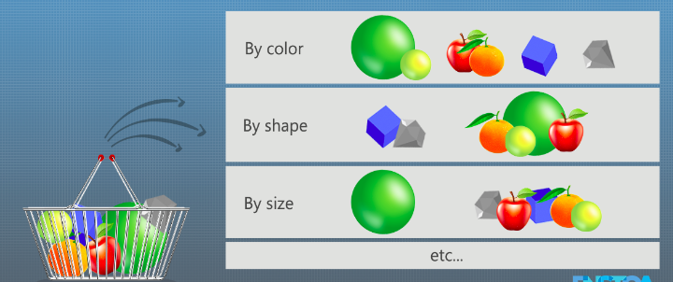
Machine Learning Tasks
Classification :
Generalize to predict discrete valued output
Classify mails into spam and ham
Clustering
Generalize to form groups
Cluster the items in a basket

Slide 11
Experience for Machine Learning : Data
Data : Qualitative or quantitative variables in organized/unorganized form
Images, Documents, Videos, Customers transactions
DATA-> Information-> Knowledge
Information : Meaningful data
Customers buying grocery items
The documents are related to sports…
Knowledge : Learned/Analyzed information
If milk is bought, then bread is also bought
Indian Cricketers are Sachin, Sehwag, Ganguly, Srinath, ….

Slide 12
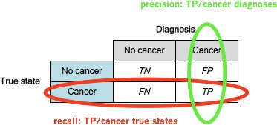
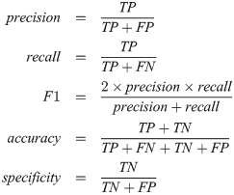
Performance measure
Accuracy : How many of the predictions made by the model are correct
Precision: Fraction of relevant instances among the retrieved instance
Recall : Fraction of the total amount of relevant instances that were retrieved actually
…………
Source : quora.com
A true positive is an outcome where the model correctly predicts the positive class.
A true negative is an outcome where the model correctly predicts the negative class.
A false positive is an outcome where the model incorrectly predicts the positive class.
A false negative is an outcome where the model incorrectly predicts the negative class.

Slide 13

Desired characteristics
Learn and Generate models of high quality
Generalize patterns with less error
Learn from noisy and vague data
Efficient and Scalable
Deterministic

Slide 14
Takeaways
Ill posed versus well posed problems
ML intends to solve optimization problems that are well posed in the form of T,E,P
ML is inductive learning
How is ML different from Conventional algorithms
Understanding of Tasks, Experience, Performance
Desired characteristics of ML

Slide 15
References
https://www.statisticshowto.com/well-posedness/
https://www.houseofbots.com/news-detail/11973-1-clarifying- differences-between-data-analysis-data-mining-data-science- machine-learning,-and-big-data
https://www.quora.com/What-is-the-best-way-to-understand-the- terms-precision-and-recall

